Slide 1

Bank Churners
MAHA ALADWANI
Mohammed AlShehri
MAHA ALHARQAN
YAZEED ALHARTHI
Junior Data Scientists
at SDAIA Academy BOOTCAMP T5

Slide 2
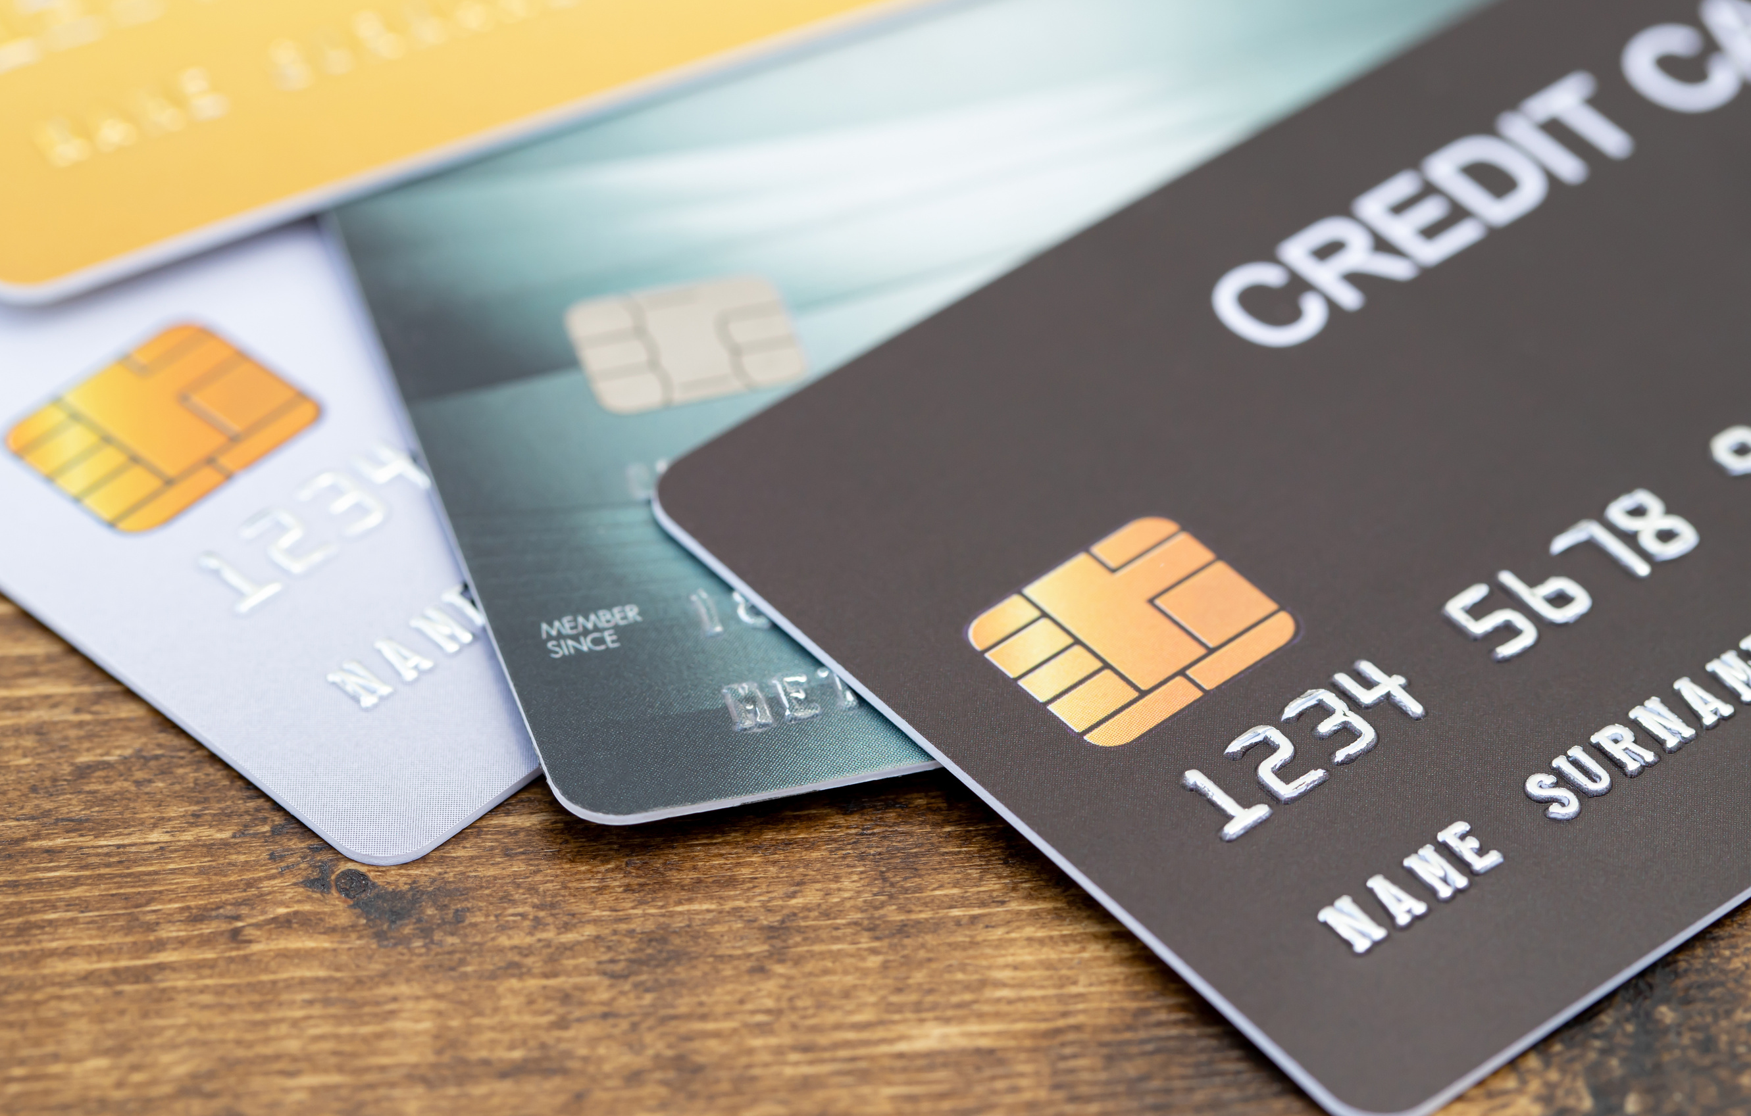
Today's Topics
OUR DISCUSSION FLOW
Introduction
About Dataset
Challenges
Questions
Algorithms
Conclusions
Tools

Slide 3

Introduction
The main purpose of this project is to classify existing and attrited customers by using classification models.
To know them so to provides them with better services, and turn customer decisions in the opposite direction.

Slide 4

About Dataset
This dataset can be found at Kaggle.
It has 10127 rows and 23 columns

Slide 5



Challenges
Dealing with null value
Dealing with imbalanced data
Choosing the right hyperparameter

Slide 6
Questions
03
01
02
04
What is the most Income Category based on Attrition Flag?
Is the Education Level affect the Income Category?
Does CustomerAge
influence the Marital Status?
Which card category has been used the most?

Slide 7
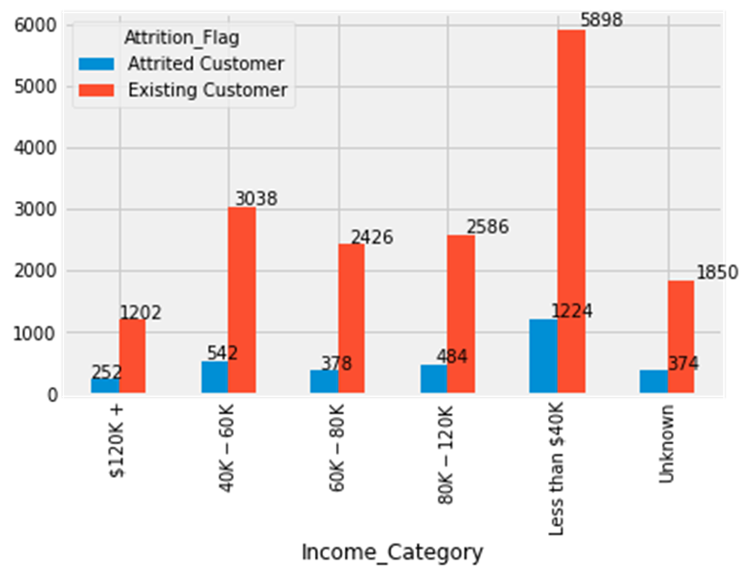
What is the most Income Category based on Attrition Flag?

Slide 8
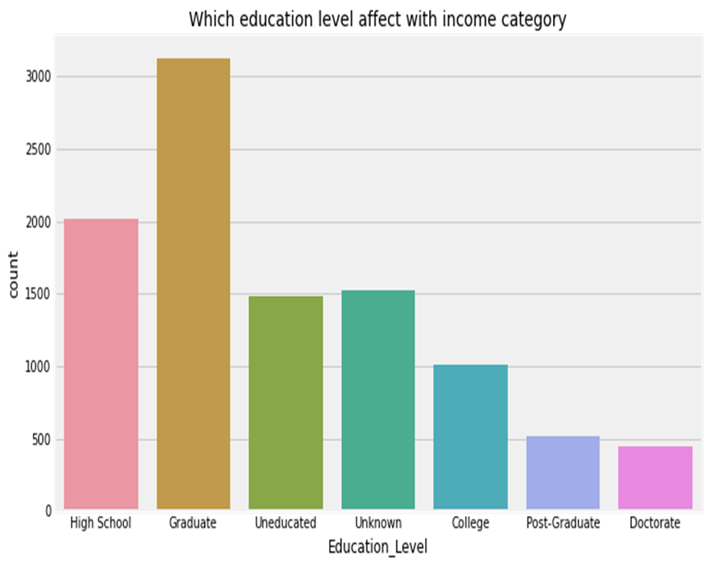
Is the Education Level affect the Income Category?

Slide 9
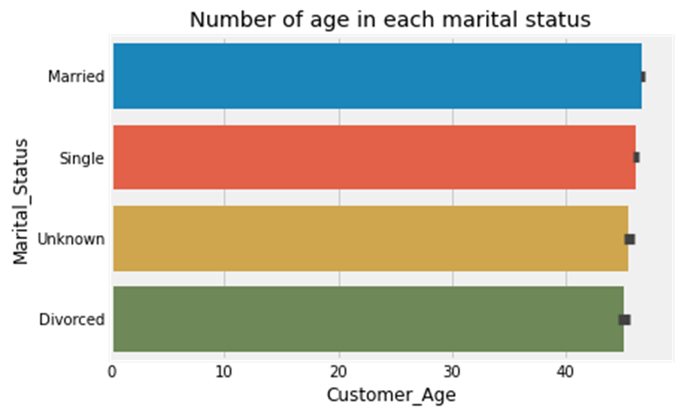
Does Customer Age influence the Marital Status?

Slide 10
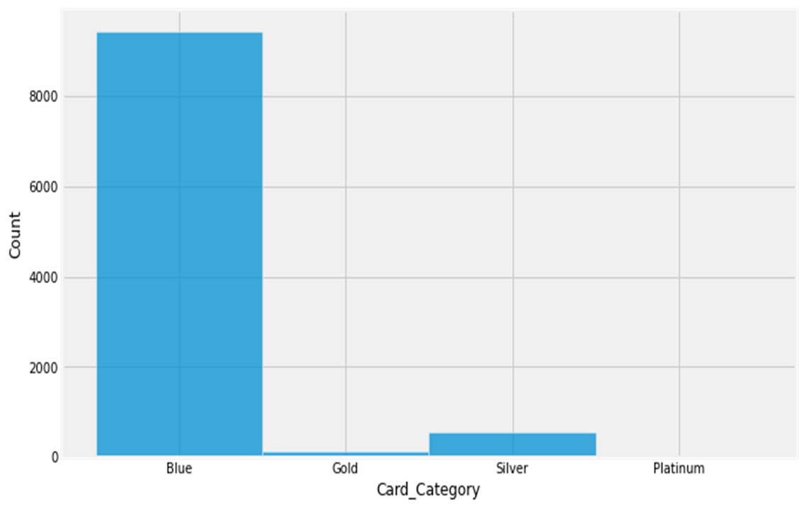
Which card category has been used the
most?

Slide 11
Algorithms
K-Nearest Neighbor
Random Forest
Logistic Regression
Extreme Gradient Boost
Decision Tree
Light Gradient Boost
Stacking

Slide 12
The prediction results for the attrited customers
After dealing with the imbalanced data
MODEL
Accuracy
Recall
Precision
F1-Score
K-Nearest Neighbor
91.79%
96.62%
88.24%
92%
Logistic Regression
93.67%
91.61%
95.68%
94%
Decision Tree
94.17%
95.45%
93.17%
94%
Random Forest
95.0%
95.69%
94.47%
95%
Extreme Gradient Boost
98.29%
98.36%
98.25%
98%
Light Gradient Boost
98.29%
98.42%
98.19%
98%

Slide 13
Comparison of the Light Gradient Boost model
Before and after dealing with the imbalanced data
LGB MODEL
Accuracy
Recall
Precision
F1-Score
Before
97.03%
86.46%
94.61%
92%
After
98.29%
98.42%
98.19%
98%

Slide 14
Comparison of the lgbm with the staking results
After dealing with the imbalanced data
MODEL
Accuracy
Recall
Precision
F1-Score
The stacking
98.17%
98.31%
98.08%
98%
Light Gradient Boost
98.29%
98.42%
98.19%
98%

Slide 15
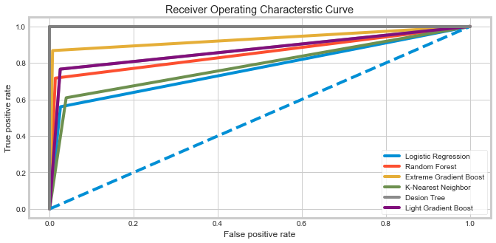
Receiver operating characteristic curve
With the imbalanced data

Slide 16
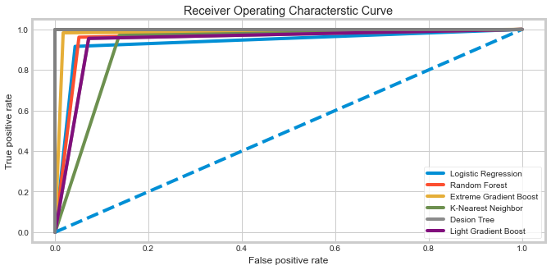
Receiver operating characteristic curve
After dealing with the imbalanced data

Slide 17

Tools
Pandas
Jupyter
Seaborn
Numpy
Python
Scikit Learn
Zoom

Slide 18
Conclusion
We found that the Light Gradient Boost model has the best results among the other models.
We found that the lowest rate of recall for the models is Logistic Regression.
Most of the customers had a blue card, so we need to market each card to build diverse categories of customers
.
We can use these models on bank websites to predict the number of users
We think that it is not necessary to use the stacking because it did not have much impact.

Slide 19

Thank You!

